Slide 1
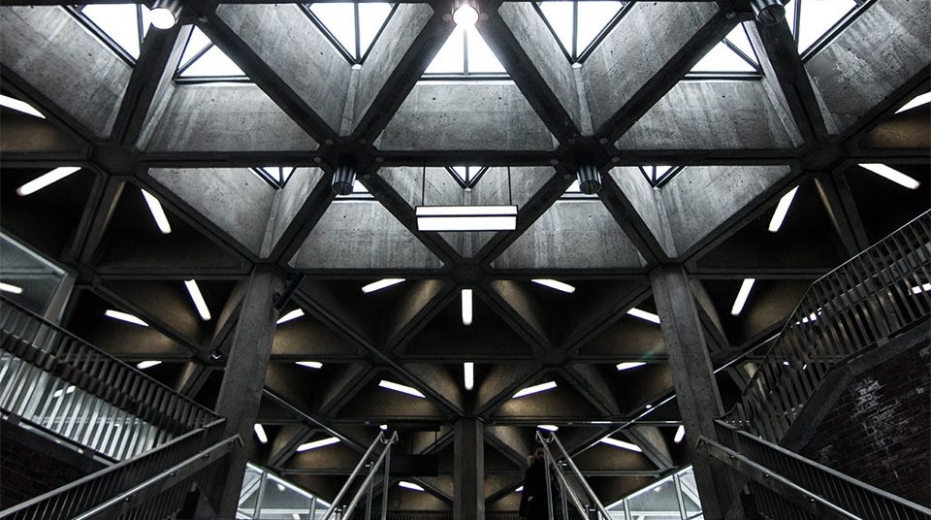
Machine Learning for Algorithmic Trading
AMLD Africa
By Mouafek Ayadi
Data Scientist at ODDO BHF
AMLD Africa

Slide 2

Title:
Table of Contents
1- Algorithmic Trading (Introduction)
2- Algorithmic Trading (Machine Learning)
3- ML Algos for Trading (Wide and Deep Learning)
4- ML Algos for Trading (Deep Reinforcement Learning)
5- ML Algos for Trading (Proposed Architecture)
6- References
7- Conclusion and Perspectives

Slide 3

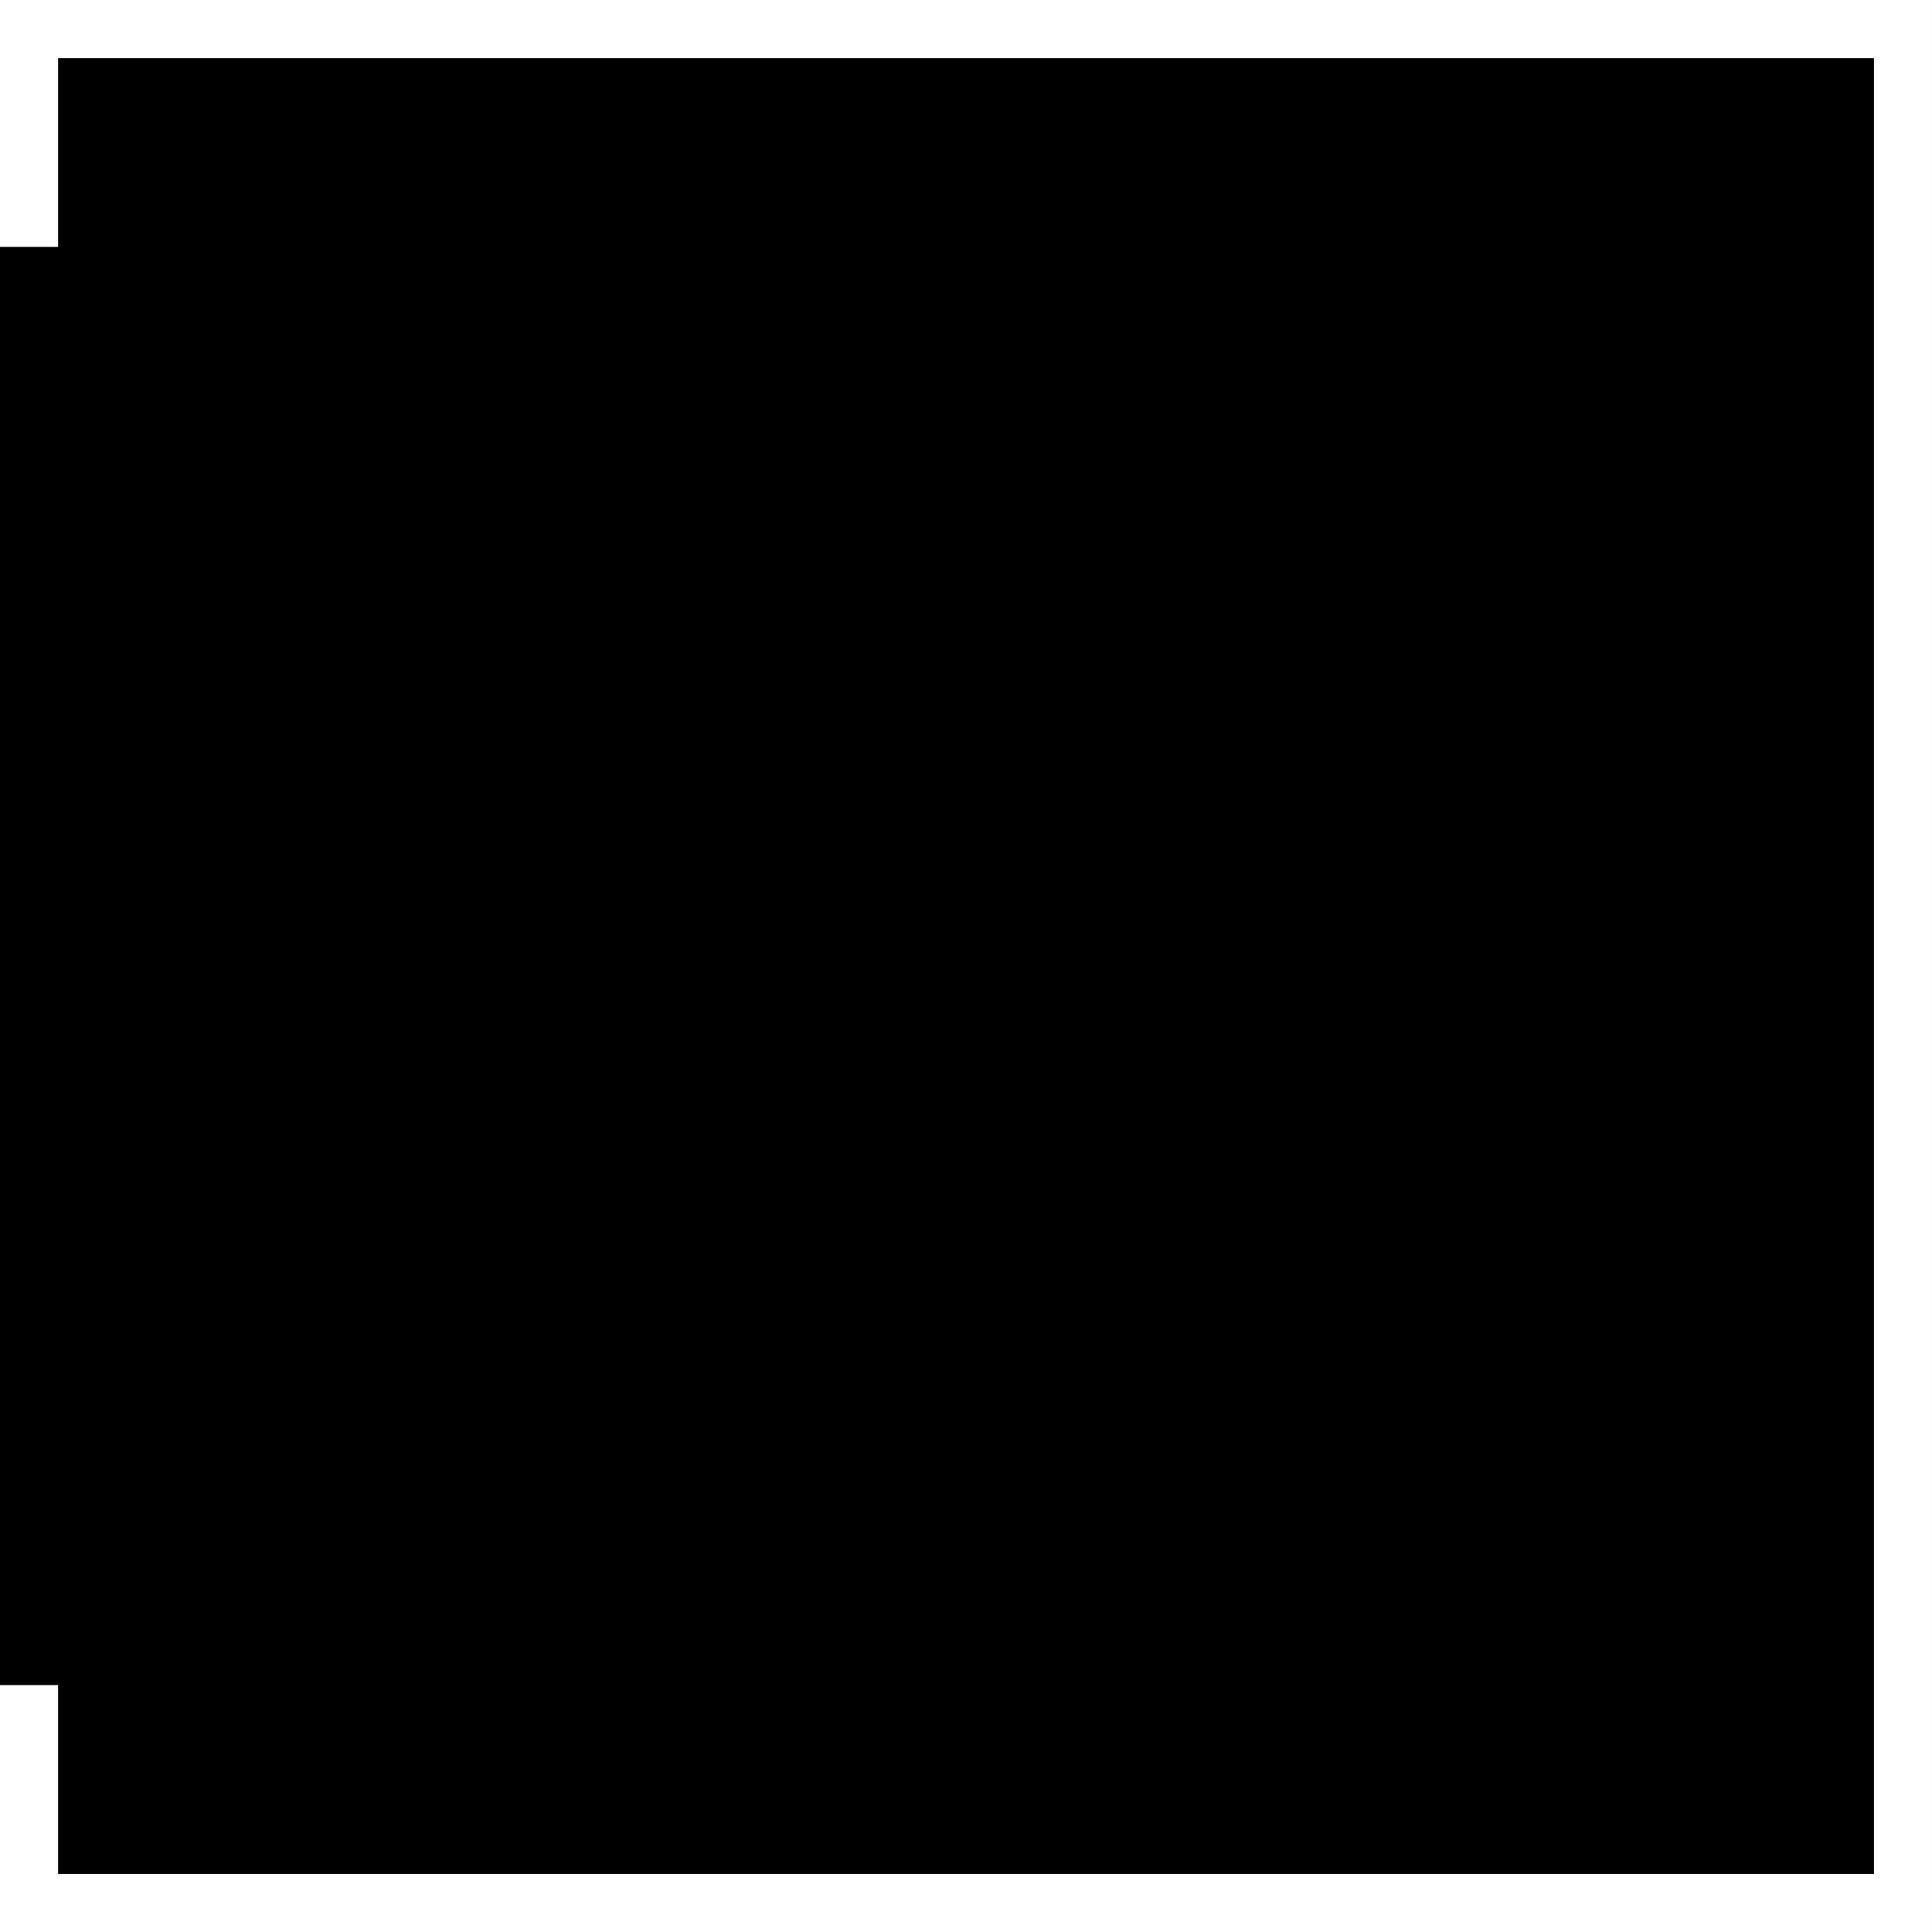
Algorithmic Trading Part 1 Introduction

Slide 4
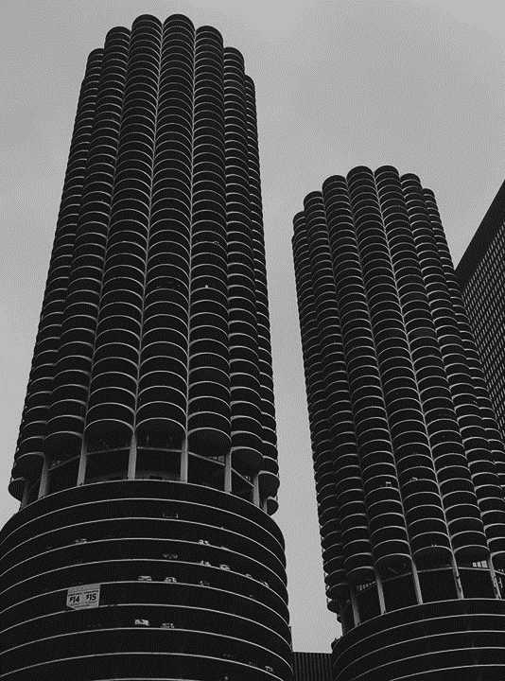
Algorithmic Trading
“Algorithmic trading is a type of quant trading that uses pre-specified machine executable instructions to determine the size and timing of trades based on a quantitative model of an asset's price behavior. Over 70 percent of US trading volume is algorithmic. Most of this volume is high-frequency trading.”[1]
Notes:
[1]
https://www.yuque.com/xhades/hs3xtz/ibg3cw

Slide 5
Algorithmic Trading Part 2 Machine Learning

Slide 6
Algorithmic Trading with Machine Learning
“Machine learning (ML) involves algorithms that learn rules or patterns from data to achieve a goal such as minimizing a prediction error. ML algorithms can extract information from data to support or automate key investment activities.
These activities include observing the market and analyzing data to form expectations about the future and decide on placing buy or sell orders, as well as managing the resulting portfolio to produce attractive returns relative to the risk.”[2]
Notes:
[2]
Stefan Jansen, founder and Lead Data Scientist at Applied AI.
https://ml4trading.io/chapter/0

Slide 7
ML Algos for Trading Part 1 Wide & Deep Learning

Slide 8
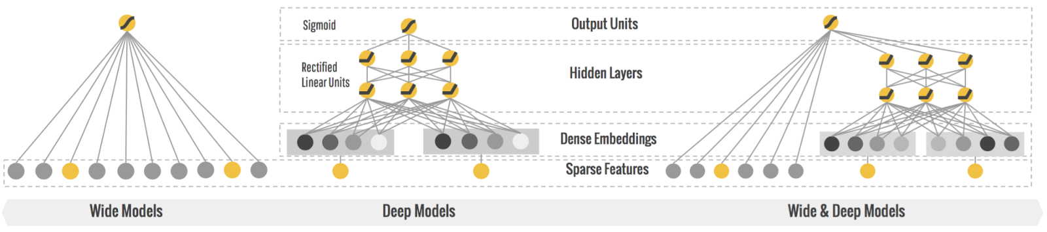
Wide & Deep Learning
“Can we teach computers to learn like humans do, by combining the power of memorization and generalization?” [3]
Wide & Deep Learning developed at Google Research was the answer to the previous question.
“It's not an easy question to answer, but by jointly training a wide linear model (for memorization) alongside a deep neural network (for generalization), one can combine the strengths of both to bring us one step closer.” [3]
“It's useful for generic large-scale regression and classification problems with sparse inputs (categorical features with a large number of possible feature values), such as recommender systems, search, and ranking problems.” [3]
AMLD Africa
Notes:
[3]
Wide & Deep Learning for Recommender Systems
https://arxiv.org/pdf/1606.07792.pdf
https://ai.googleblog.com/2016/06/wide-deep-learning-better-together-with.html

Slide 9
ML Algos for Trading Part 2 Deep Reinforcement Learning

Slide 10
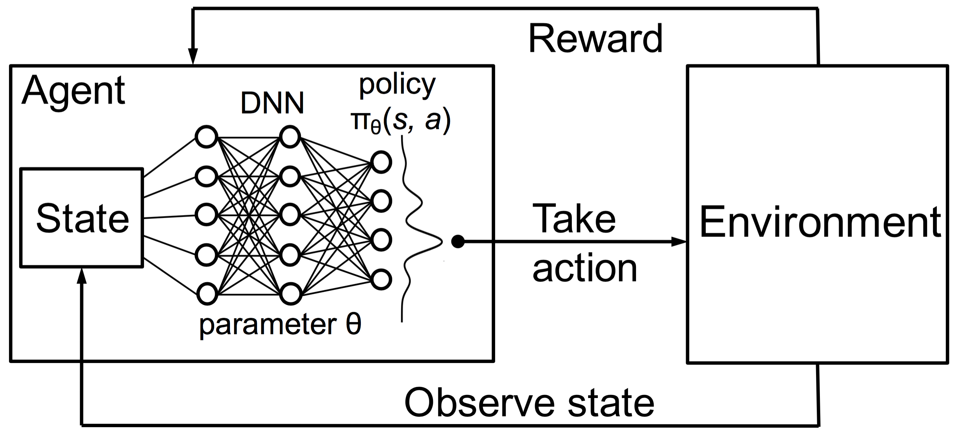
Deep Reinforcement Learning
Intro
“Deep reinforcement learning is the combination of reinforcement learning (RL) and deep learning. This field of research has been able to solve a wide range of complex decision-making tasks that were previously out of reach for a machine.
Thus, deep RL opens up many new applications in domains such as healthcare, robotics, smart grids, finance, and many more.” [4]
Notes:
[4]
Vincent Francois-Lavet, An Introduction to Deep Reinforcement Learning
https://arxiv.org/abs/1811.12560

Slide 11
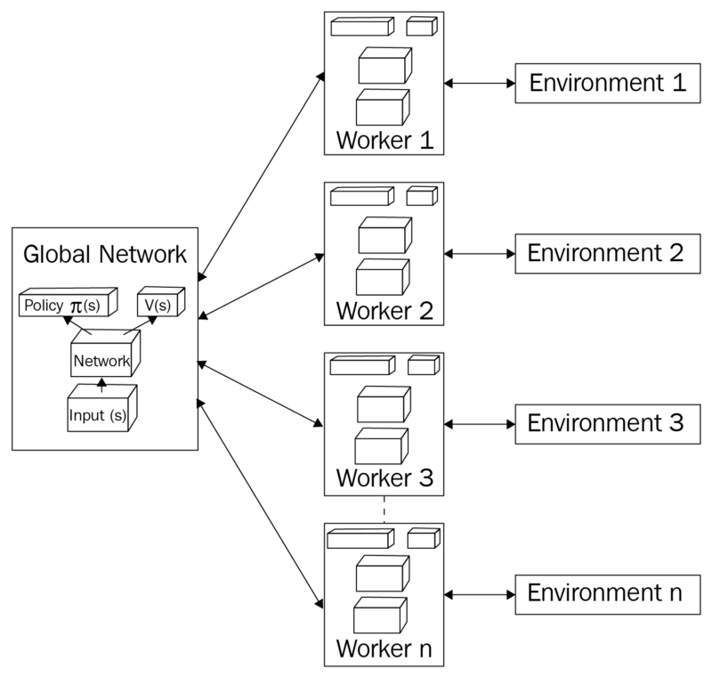
Deep Reinforcement Learning
A3C
The Asynchronous Advantage Actor Critic (A3C) was developed by Google's DeepMind.
A3C consists of multiple independent agents(networks) with their own weights, who interact with a different copy of the environment in parallel.
“We now describe our variants of one-step Q-learning, one-step Sarsa, n-step Q-learning and advantage actor-critic”. [5]
Notes:
[5]
Asynchronous Methods for Deep Reinforcement Learning
https://arxiv.org/pdf/1602.01783.pdf

Slide 12
ML Algos for Trading Part 3 proposed Architecture

Slide 13
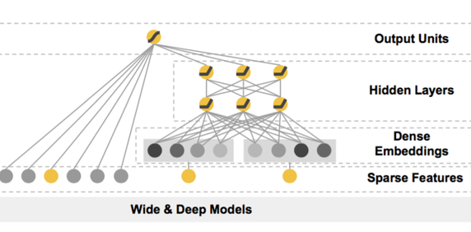
Deep Reinforcement Learning for Trading A3C with Wide & Deep Networks
AMLD Africa
Notes:
A3C consists of multiple independent agents(networks) with their own weights, who interact with a different copy of the environment in parallel.
In order to make the Artificial Neural Network more compliant with the Financial markets where the agents operates in, we define a Wide & Deep Models,
where

Slide 14
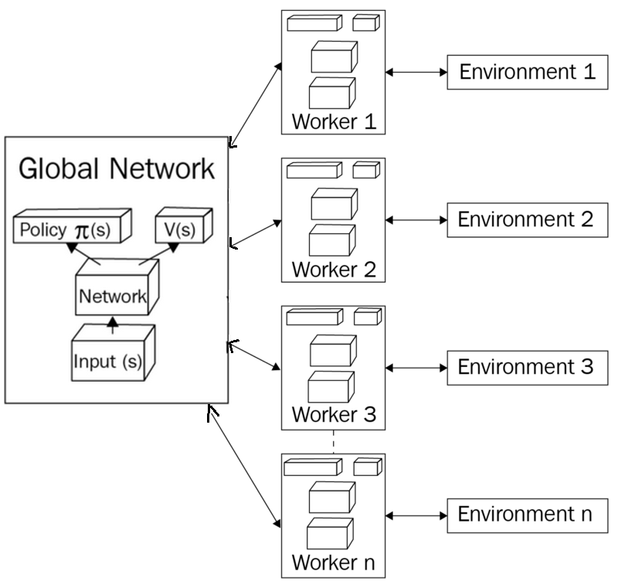
Deep Reinforcement Learning for Trading A3C with Wide & Deep Networks
In a single financial market we can implement A3C that consists of multiple independent agents(networks) with their own weights that can operate in different sectors, who interact with a different copy of the environment in parallel used to simulate different sector scenarios.
Our idea is to make the Model-Free A3C bound by the market previous behavior and current trends, in order to predict seconds ahead of recent stock values.
In order to make the Artificial Neural Network more compliant with the Financial markets and their respective sectors where the agents operates in, we define a Wide & Deep Models, where wide linear model is used for memorization (historical market/sector pattern),
alongside a deep neural network used for generalization (detect new market/sector pattern).
AMLD Africa
Notes:
In a single financial market we can implement A3C that consists of multiple independent agents(networks) with their own weights that can operate in different sectors, who interact with a different copy of the environment in parallel used to simulate different sectors scenarios,
Our idea is to make the Model-Free A3C bound by the market previous behavior and current trends, in order to predict seconds ahead of stock values.
In order to make the Artificial Neural Network more compliant with the Financial markets and their respective sectors where the agents operates in,
we define a Wide & Deep Models, where wide linear model is used for memorization (historical market/sector pattern),
alongside a deep neural network used for generalization (detect new market/sector pattern).

Slide 15
Title:
Personal Work (ongoing)
https://github.com/MWFK/Market_Prediction-Building_Trading_Strategies
References
[1] https://www.yuque.com/xhades/hs3xtz/ibg3cw
[2] https://ml4trading.io/chapter/0
[3] https://arxiv.org/pdf/1606.07792.pdf
[4] https://arxiv.org/abs/1811.12560
[5] https://arxiv.org/pdf/1602.01783.pdf

Slide 16
THANK YOU
Q & A

